Slide 1
Text Classification
Team Members:
M. Usha Kiran (S170075)
R. Sri Ram (S170209)
G. Lavanya (S170417)
Under Supervisation of:
Mr. Pavan Baswani Sir

Slide 2
Problem Statement
The emergence of social media has fundamentally altered how people obtain information. Platforms like Facebook and Twitter enable the speedy, widespread, and unrestricted dissemination of information, but they also act as a breeding ground for false information. During the epidemic, a sizable amount of tweets regarding COVID-19 misled people about the actual news. The study found that incorrect information regarding the coronavirus is disseminating more quickly than accurate information. These fraudulent tweets also seriously endanger people's lives. Using a real-world dataset related to the most current COVID-19 epidemic, we may utilise text classification, an NLP approach, to resolve the problem of fake tweets by determining if they are authentic or not.

Slide 3
Existing Model
Other contributions from the team include cross-SEAN, a model for identifying real from fake tweets, and CTF, the first corona virus Twitter dataset (cross stitch-based semi supervised end-to-end neural attention model). The CTF dataset has 45.26k tweets in total, of which 18.55k have been found to be true and 26.71k to be fake. When they compared the behaviour of their model with that of seven currently employed methodologies, their model outperformed all others, scoring a 0.95 F1 score. Fake news is currently widely spread for a variety of social, political, and economic purposes.

Slide 4
News of the coronavirus has also had a significant influence on the offline community. In these conditions, it is more important than ever to distinguish between authentic and bogus COVID-19 news in order to allay fears about this dangerous virus. They used a binary COVID-19 false news classification dataset that was available online. They employed TF and IDF to extract the features after pre-processing the dataset. Then, they train their model using decision trees and random forests, and they evaluate it using a variety of parameters. The proposed model had DT classifier accuracy of 92.07% and RF classifier accuracy of 94.49%.

Slide 5
Our Solution

Slide 6
Logistic Regression
Logistic regression is a statistical analysis method to predict a binary outcome, such as yes or no, based on prior observations of a data set.
A logistic regression model predicts a dependent data variable by analysing the relationship between one or more existing independent variables.
For example, a logistic regression could be used to predict whether a political candidate will win or lose an election or whether a high school student will be admitted or not to a particular college.
These binary outcomes allows straightforward decisions between two alternatives.

Slide 7
Support vector Machine
A SVM is a supervised learning models with associated learning algorithms that analyse data for classification and regression analysis.
SVMs are one of the most robust prediction methods, being based on statistical learning frameworks.
SVMs can efficiently perform a non-linear classification using what is called the kernel trick, implicitly mapping their inputs into high-dimensional feature spaces.
Support vector machine is highly preferred by many as it produces significant accuracy with less computation power

Slide 8
Boosting
Boosting is an ensemble meta algorithm for primarily reducing bias.
And also variance in supervised learning, and a family of machine learning algorithms that convert weak learners to strong ones.
Most boosting algorithms consist of iteratively learning weak classifiers with respect to a distribution and adding them to a final strong classifier.
When they are added, they are weighted in a way that is related to the weak learners' accuracy.

Slide 9
Naïve Bayes
Naive Bayes is a simple technique for constructing classifiers: models that assign class labels to problem instances, represented as vectors of feature values, where the class labels are drawn from some finite set.
Naive Bayes classifiers are highly scalable, requiring a number of parameters linear in the number of variables in a learning problem.
Maximum-likelihood training can be done by evaluating a closed-form expression, which takes linear time, rather than by expensive iterative approximation as used for many other types of classifiers.

Slide 10
Multilayer Perceptron
A multilayer perceptron (MLP) is a fully connected class of feed forward artificial neural network (ANN).
An MLP consists of at least three layers of nodes: an input layer, a hidden layer and an output layer.
MLP utilizes a supervised learning technique called back propagation for training. Its multiple layers and non-linear activation distinguish MLP from a linear perceptron.
The input layer receives the input signal to be processed. The required task such as prediction and classification is performed by the output layer. An arbitrary number of hidden layers that are placed in between the input and output layer are the true computational engine of the MLP

Slide 11
Bi-LSTM
Bidirectional long-short term memory(Bi-LSTM) is the process of making any neural network to have the sequence information in both directions backwards (future to past) or forward(past to future).
Bidirectional LSTMs in short Bi-LSTM is an addition to regular LSTMs which is used to enhance the performance of the model on sequence classification problems.
Bi-LSTMs use two LSTMs to train on sequential input. The first LSTM is used on the input sequence as it is.
The second LSTM is used on a reversed representation of the input sequence. It helps in supplementing additional context and makes our model fast.

Slide 12
BERT
BERT-Bidirectional Encoder Representations from Transformers.
BERT is designed to help computers understand the meaning of ambiguous language in text by using surrounding text to establish context.
It is based on Transformers, a deep learning model in which every output element is connected to every input element, and the weightings between them are dynamically calculated based upon their connection.
Transformer allows the BERT model to understand the full context of the word, and therefore better understand searcher intent.

Slide 13
Models | Word Embedding Methods | Accuracy Score | F1 Score
Logistic Regression | Count Vectorizer | 0.92 | 0.92
 | Word Level TF-IDF | 0.92 | 0.92
 | NGram TF-IDF | 0.84 | 0.84
 | Char TF-IDF | 0.91 | 0.91
Naïve Bayes | Count Vectorizer | 0.92 | 0.92
 | TF-IDF | 0.90 | 0.90
Boosting | Count Vectorizer | 0.92 | 0.92
 | Word Level TF-IDF | 0.91 | 0.91
 | NGram TF-IDF | 0.84 | 0.84
 | Char TF-IDF | 0.95 | 0.95
SVM | Count Vectorizer | 0.52 | 0.69
 | Word Level TF-IDF | 0.52 | 0.69
 | NGram TF-IDF | 0.52 | 0.69
 | Char TF-IDF | 0.52 | 0.69
MLP | Count Vectorizer | 0.91 | 0.91
 | Word Level TF-IDF | 0.91 | 0.91
 | NGram TF-IDF | 0.88 | 0.88
 | Char TF-IDF | 0.90 | 0.90
Bi-LSTM | - | 0.92 | 0.92
Bert | - | 0.96 | 0.96

Slide 14
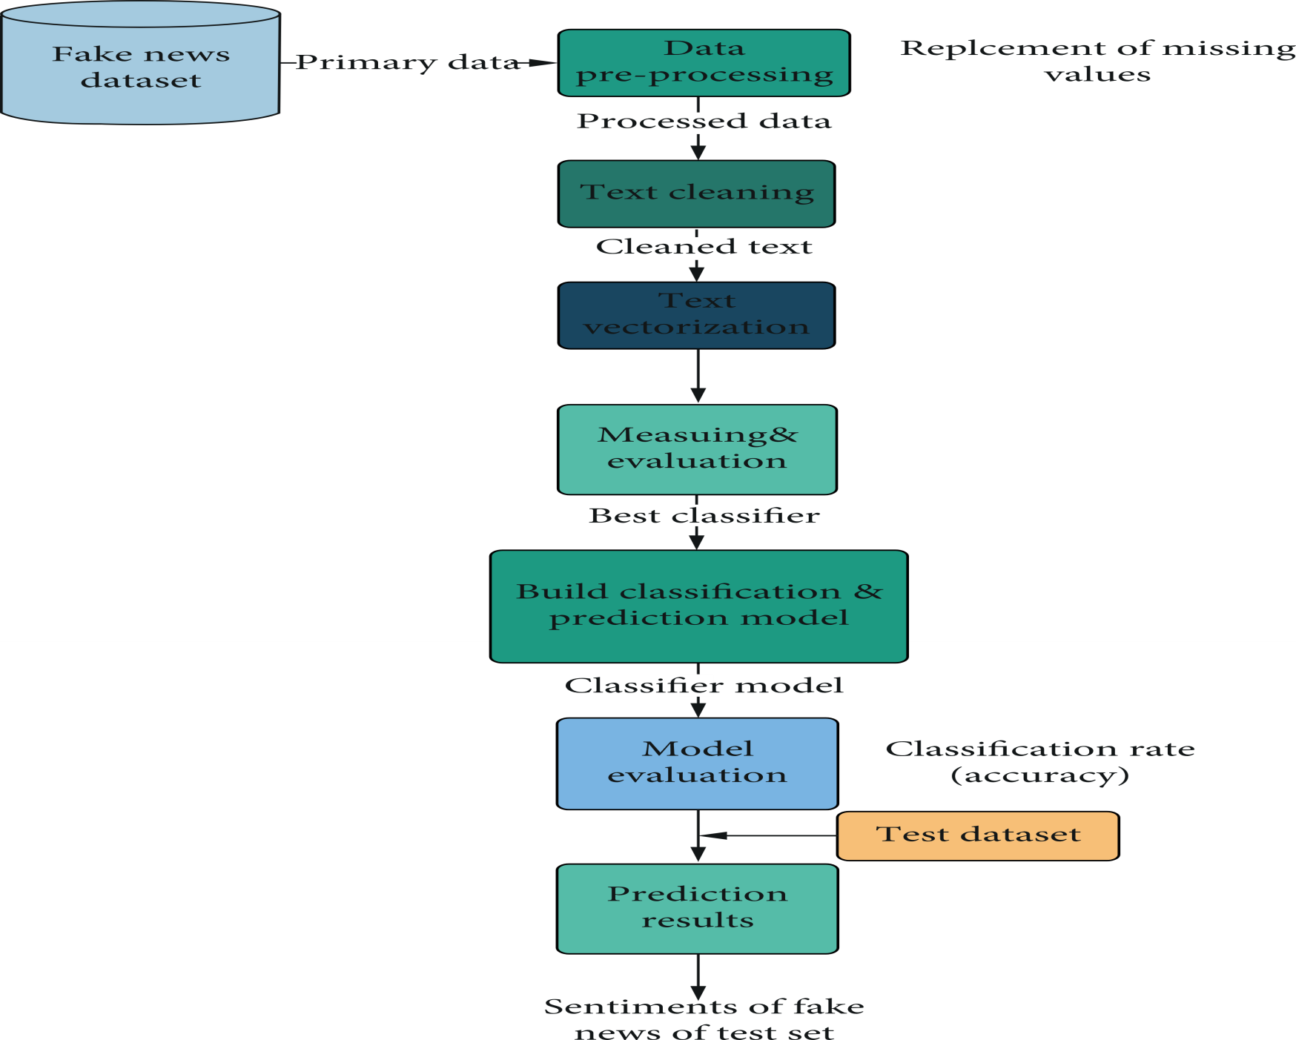
Model Architecture
Classifying whether Real or Fake

Slide 15
Model Results and Discussions
The aforementioned tables show the results of all machine learning-based models that were evaluated.
All of the classifiers displayed excellent performance, however when compared to other machine learning classifiers, some performed better than others in terms of accuracy and f1-score.
On a sizable dataset made up of COVID-19 Tweets, we tried multiple algorithms. Our dataset has been split in half, with one half used for testing and the other for training. Bert and Boosting models outperformed all others with accuracy scores of 0.96 and 0.95, respectively.

Slide 16
Conclusion
According to the project's findings, we employed seven different classifiers: NAVE BAYES, BOOSTING, SVM, BERT, BI-LSTM, MLP, and LR to determine whether a tweet was legitimate or fraudulent using text classification technique.
Our analysis of the various metrics reveals that, despite machine learning algorithms' good accuracy score of 0.96, the BERT model outperforms other learning techniques.
To select or modify the best classifier, we evaluated numerous approaches and ran experiments on a dataset from a trustworthy repository. The system has also been examined in terms of accuracy and F1-score for each algorithm.

